Slide 1
About Physical Medicine and Rehabilitation (PM&R)

Slide 2
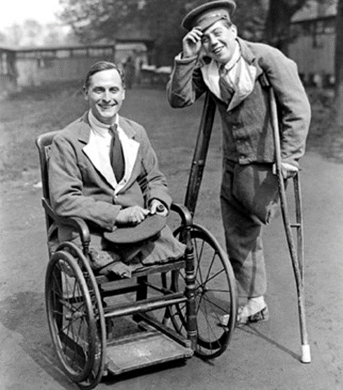
History of PM&R
PM&R emerged due to observations by surgeons during the Revolutionary and Civil Wars: soldiers who ignored “bed rest” recommendations recovered faster and more fully.
National crises fueled the need for large scale physical rehabilitation: paralysis caused by the polio epidemic, and war injuries from WWI and WWII.
Patients with disabling conditions required reintegration into the workforce
Creative recovery programs and assistive technologies evolved to fill the need
In the 1920s, the U.S. Army had two medical branches: the department of surgery and the department of physical reconstruction (underscoring the early recognition of rehabilitation as foundational to healthcare)* *https://ke.army.mil/bordeninstitute/published_volumes/rehab1/RH1ch1.pdf

Slide 3
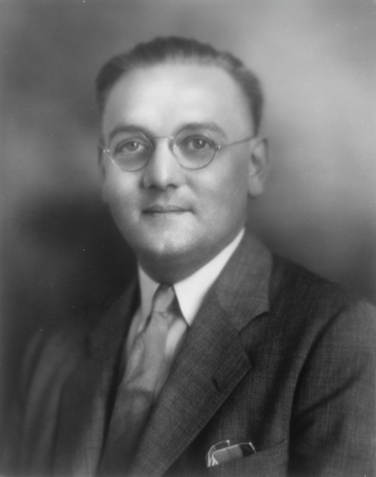
The Founder of PM&R
In the early 1920s, Dr. Frank Krusen contracted tuberculosis as a surgical resident and spent months recovering in a sanitorium. There he recognized that physical exercise was integral to his successful recovery.
At the same time, a small group of surgeons (who believed in the power of early mobility) began to call themselves “physical therapists” and Dr. Krusen sought to clarify differences between physicians and other clinicians who practiced physical medicine (known then as occupational aides and physiotherapy aides, now OT and PT).
He established a program in physical therapy and an inpatient rehabilitation unit at Temple University, where he became Dean in 1926 at the age of 28. In 1936, Dr. Krusen moved to the Mayo Clinic and developed a department of physical medicine and established the first United States residency training program.

Slide 4
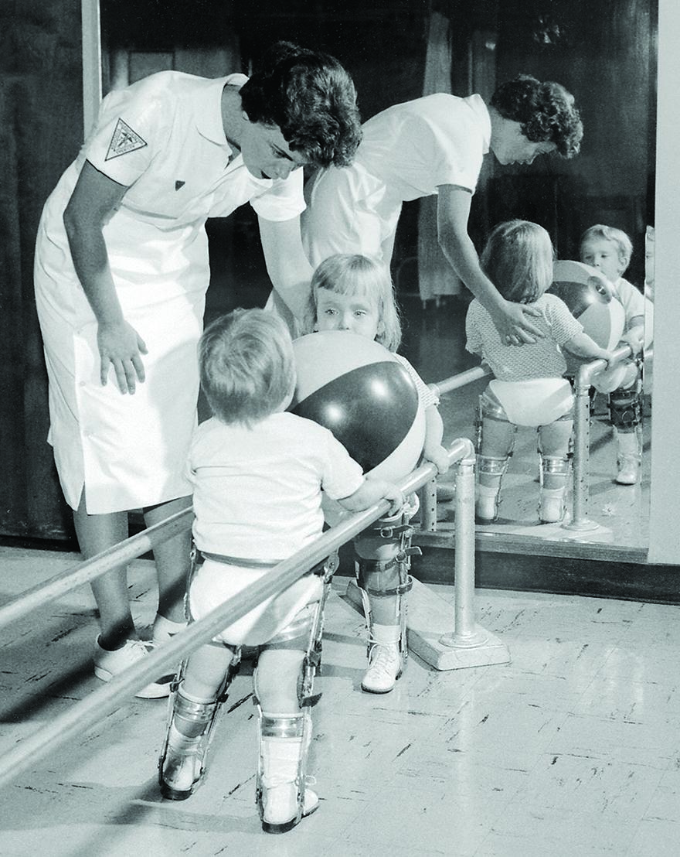
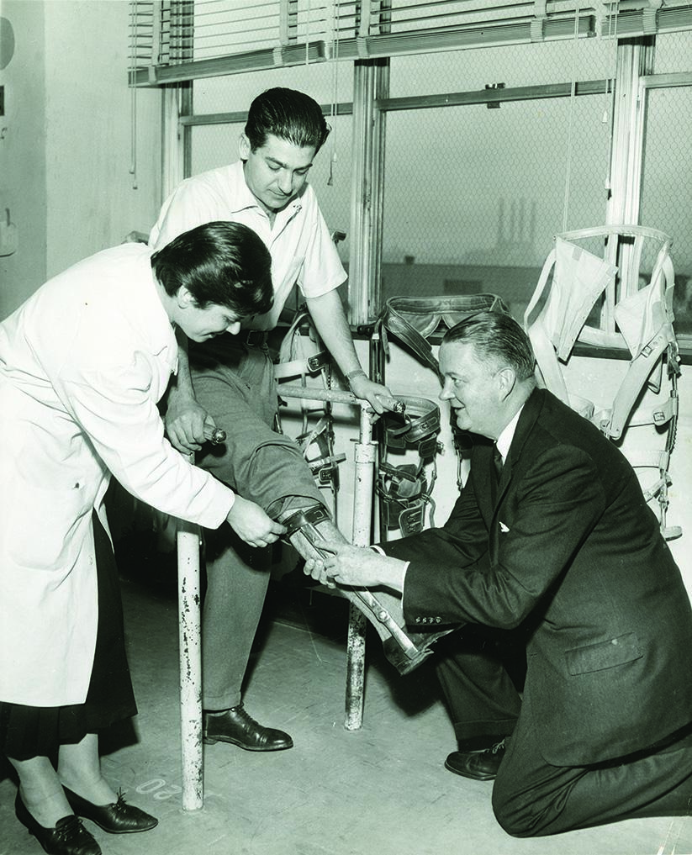
History of PM&R
The American Board of Medical Specialties officially recognized the specialty of PM&R in 1947.
The professional society for PM&R physicians, The American Academy of Physical Medicine and Rehabilitation, was founded in 1955.
The rise of technology has led to further innovations, including personalized medicine, high-performance prosthetics, implantable pain management systems, and equipment that allows high intensity stroke and brain injury recovery programs.

Slide 5
About PM&R
Emergency Physician
First Response
Stabilize Patient
PM&R is one of the specialties organized around a timeframe of illness.
Critical Care Physician
Keep Alive
Optimize Organs
PM&R Physician
Begin Recovery
Regain Function
Maintain Function

Slide 6
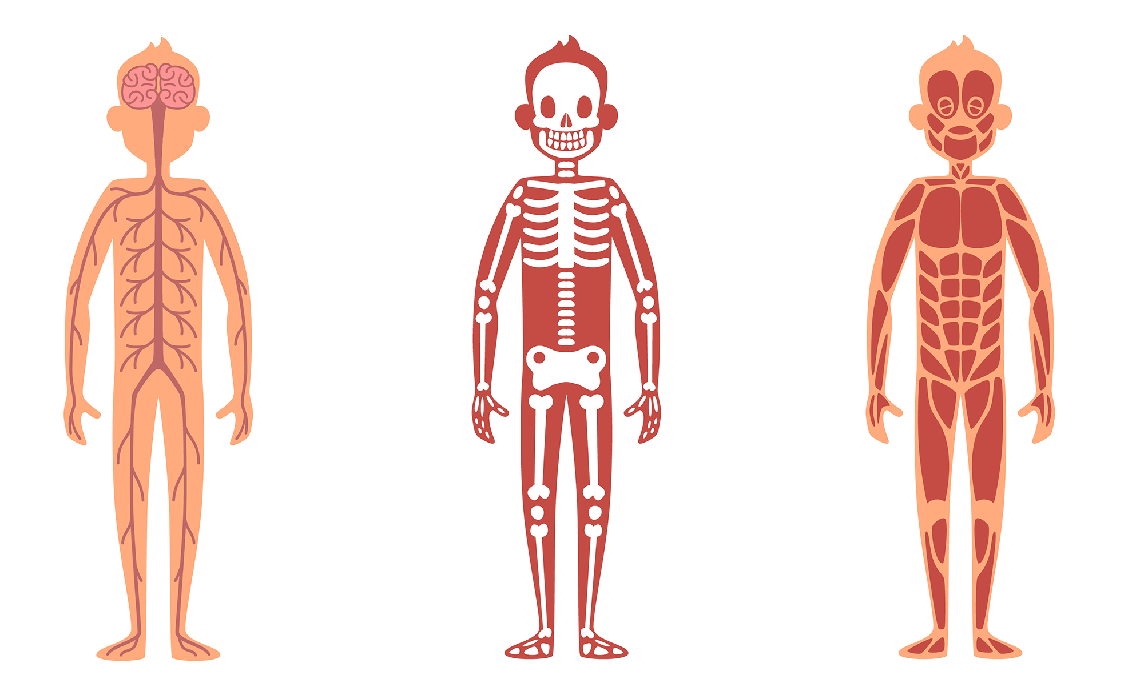
About PM&R
PM&R customizes recovery options for each individual.
The highest level of independence is achieved with a combination of:
Intensive therapies and physical exercise
Optimized medication regimens
Assistive device training
Adaptive equipment
Caregiver training
Ongoing practice and repetition
Pain management
Brain
Spinal Cord
Tendons
Ligaments
Bones
Nerves
Joints
Muscles

Slide 7
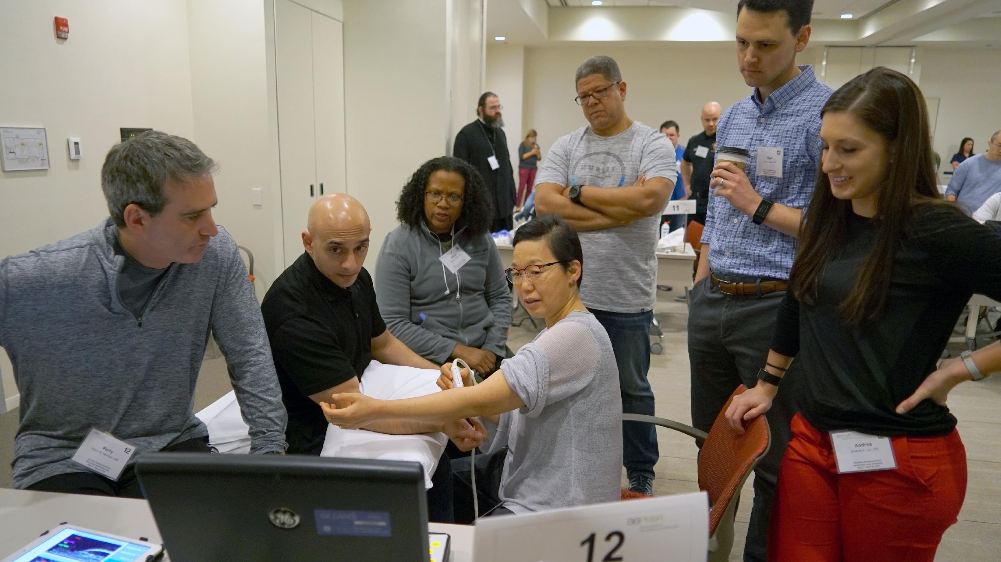
About PM&R Physicians
As a specialty, PM&R physicians are detectives, identifying root causes of disability, and removing barriers to living independently.
PM&R physicians create custom recovery plans to help patients achieve specific goals (e.g., to be able to walk, to live alone, play a sport, or return to work).
By speeding recovery, PM&R physicians can reduce hospital length of stay, improve pain management, and partner with therapists to teach patients self-reliance, thus minimizing hospital readmissions.
Early hospital consultation with PM&R physicians can reduce unnecessary procedures, guide post-acute care planning, enhance self-care skills, increase patient satisfaction, reduce polypharmacy and decrease the overall cost of care.

Slide 8
What is the Role of PM&R Physicians?
PM&R physicians…
Think about how patients can get back to thriving in their lives as quickly as possible. “What do you want to be able to do?” is often our first patient question.
Specialize in recovery from all debilitating conditions, recognizing that physical movement, personal independence and cognitive exercise are fundamental to health and well-being.
Utilize cutting‐edge as well as time‐tested treatments to maximize function and quality of life.
Find the minimum effective dose of medications and use multi-modal pain management strategies to reduce opioid use
Treat patients with short- or long-term physical and/or cognitive impairments and disabilities (from sports injuries to spinal cord and brain injury medicine).

Slide 9
PM&R: Across Healthcare Teams
PM&R physicians collaborate with many physician specialties including:
Orthopedic surgery
Neurology
Neurosurgery
Cardiopulmonary Medicine
Primary care (family medicine, pediatrics, internal medicine)
Oncology
PM&R physicians lead teams of clinicians to support the multidisciplinary care of patients:
Physical therapists
Occupational therapists
Speech-language pathologists
Psychologists and neuropsychologists
Respiratory therapists
Prosthetics and orthotics specialists
Recreation therapists

