Slide 1
Copy
Virtual Faculty Toolkit
Tips, Tricks & How to Prepare

Slide 2
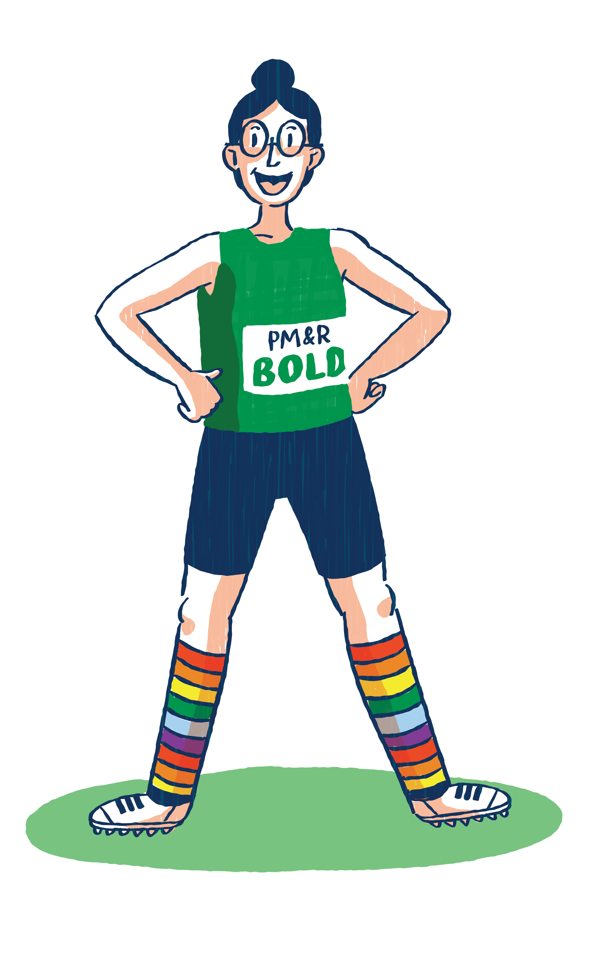
Setting the Scene
Webcam Visuals | What to Wear/Not to Wear
Keep your background as simple as possible to avoid distracting your audience’s attention from your presentation. | Try to avoid busy patterns. Patterns may distract your audience’s attention from your presentation.
Your eyes should peer directly into the webcam. Adjust your computer or laptop so that the webcam is in your direct line of sight. | Avoid high contrast colors (white, black). Cool, jewel tone colors work best.
Lighting is important! Position yourself so that you are facing a window or light. This will ensure that you are clearly visible during your presentation. | Avoid shiny accessories. Dangly earrings and jewelry can reflect off your room’s lighting and create a glare.
Your head and should take up most of the frame. | AAPM&R swag is always encouraged!

Slide 3
Let’s Get Technical
The virtual platform is designed to work on web-based applications (Chrome, Firefox, and Internet Explorer). You can access the platform from your laptop, tablet or mobile device. Mute all electronic devices in the room. Close out all applications on your device. | If you are using a laptop, plug it in and leave it plugged in! If you have a hardline internet connection, we suggest you use it. If you do not have a hardline, use high-speed internet to ensure a strong connection.

Slide 4
Engagement
Engagement is an important part of learning. Consider including tools such as polling features, Q&A functions and live chat during live presentations to facilitate interactivity. The Annual Assembly has a presence on several social media channels and is always looking to creatively engage attendees. Use the hashtags below to market your session! Twitter: @aapmr #aapmr20 Instagram: @aapmr #aapmr20 Facebook: @aapmrinfo #aapmr20 YouTube: aapmrsite

Slide 5
Practice Makes Perfect!
Rehearse your presentation prior to recording.
Consider using a mirror so that you can see how you look while presenting.
Record yourself or deliver your presentation in front of a friend or colleague to get some feedback.
Make sure you are comfortable with the recording platform.
AAPM&R staff will schedule a rehearsal with the recording platform to make sure you are prepared
too!

Slide 6
Show Time!
You only have a couple minutes before your audience decides to click away or checkout - Make a strong first impression. Use your voice to guide viewer attention. Vary your pitch and volume to keep your audience engaged. Pay attention to talking slowly and clearly. The quality of sound and video may not always be perfect during a virtual session. | Use a strong, clear voice. It will not only be more audible, but it will also convey confidence. Place a ‘Do Not Disturb’ sign on your door to let others know that you are presenting.

Slide 7
Frequently Asked Questions
Who is my target audience?
During the AAPM&R Annual Assembly, you will be instructing physiatrists, advanced practice providers, physical therapists and residents.
Is there an Academy template I should use for my presentation?
All presenters are required to use the AAPM&R PowerPoint Template (PPT) which is already formatted to 16.9 resolution for best quality.

Slide 8
Frequently Asked Questions
Will there by technical help during my live and/or on-demand recording session?
An AAPM&R staff member and technical support from our virtual recording platform will be available to assist you as you record your presentation.
Will there be a rehearsal prior to my live session?
An AAPM&R staff member and technical support from our virtual recording platform will be available to assist you as you record your session.
How long will my presentation be available on-line?
On-Demand sessions will be available for registered attendees from November 9, 2020 until January 31, 2021 in our virtual platform. This allows plenty of time for promotion of individual sessions.

Slide 9
Frequently Asked Questions
How many health care professionals participate in the AAPM&R Annual Assembly?
Attendance varies depending on the Assembly timing and location. The AAPM&R anticipates between 2500-2800 healthcare professionals to participate in the 2020 Annual Assembly.
Will my session be evaluated?
Attendees have the option to evaluate your session. Attendees will be directed to a link to complete the evaluation once your session has concluded.
Questions? Contact the AAPM&R National Office at assembly@aapmr.org or (847) 737-6000.

